Slide 1

Notes:
Sherman Kent, was a Yale University history professor who, during World War II and through 17 years of Cold War-era service in the Central Intelligence Agency, pioneered many of the methods of intelligence analysis. He is often described as "the father of intelligence analysis". -Wikipedia

Slide 2
Module 9: Confidence Intervals (or Interval Estimation)

Slide 3
Parameter vs. Statistics (Revisit)
Parameter is defined as a number from the population and its value is unknown.
However, we really want to learn something about it.
Instead, we draw a decent sample (from the population) and get a statistic.
In short, a statistic (from the sample) is used to estimate the parameter (of interest).
Key condition in hypothesis testing: values of parameters are always unknown.

Slide 4
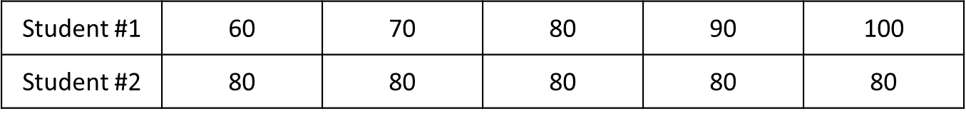
Precision vs. Uncertainty
Precision is loosely defined as how close all the measurements are to each other.
In statistics, if you consider the “measurement” as the response from subjects, then precision can be measured by standard deviation, for example.
In the following example, Student #1 is more “varied” (than Student #2), hence less “precise”.
In this module, “higher precision” means “longer margin of error”.

Slide 5
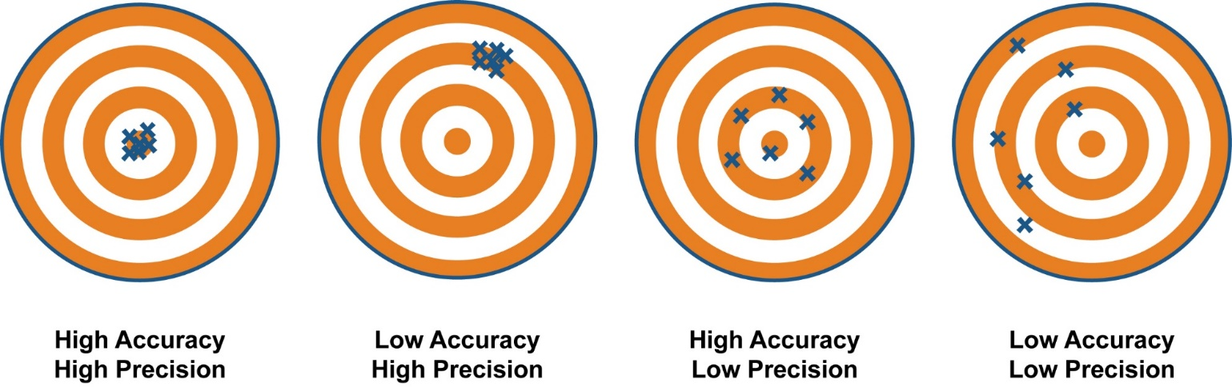
Accuracy vs. Confidence Level
Accuracy is loosely defined as how close the measurement(s) is(are) to the target.
In statistics, the “target” is the value of the parameter, which is typically unknown to us. Hence, no point to discuss Accuracy.
That said, accuracy is typically directly proportional to Confidence Level.
Confidence level is simply how confidence you are about the accuracy of things.
In this module, “higher accuracy” will give a “longer margin of error”.

Slide 6
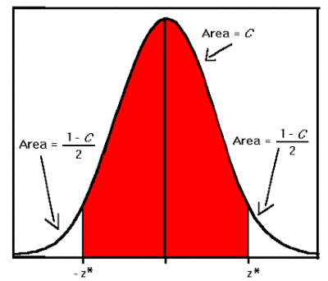
Confidence Level to Z-scores
Confidence level is simply a probability and usually expressed in percentage.
In fact, the confidence level always takes up the “middle” area of the Z-distribution (or t-distribution).
Confidence Level | Z
90% | 1.645
95% | 1.96
99% | 2.58
80% | ??

Slide 7
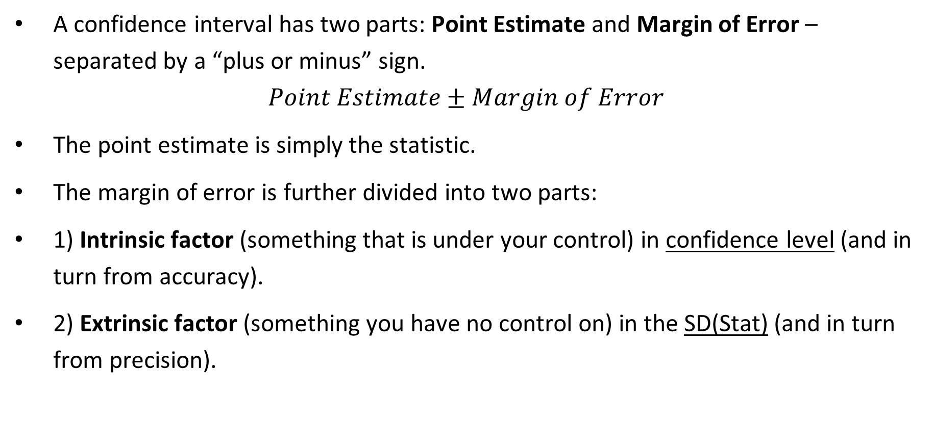
Confidence Intervals - Form
A confidence interval has two parts: Point Estimate and Margin of Error – separated by a “plus or minus” sign.
$$Point Estimate±Margin of Error$$
The point estimate is simply the statistic.
The margin of error is further divided into two parts:
1) Intrinsic factor (something that is under your control) in confidence level (and in turn from accuracy).
2) Extrinsic factor (something you have no control on) in the SD(Stat) (and in turn from precision).

Slide 8
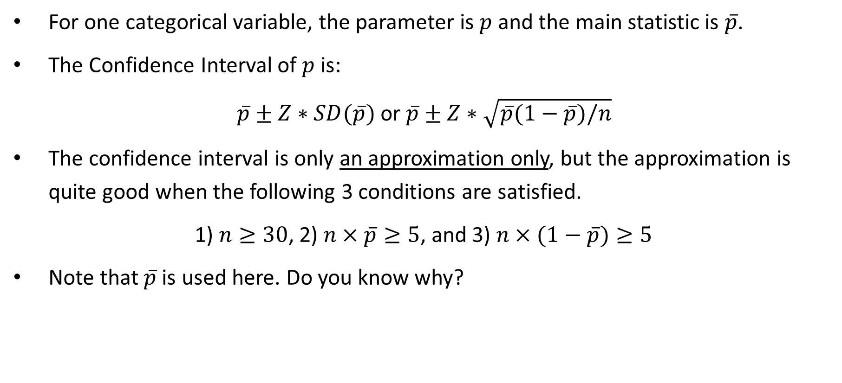
Confidence Intervals (Proportions)
For one categorical variable, the parameter is $p$ and the main statistic is $\overline{p}$.
The Confidence Interval of $p$ is:
$\overline{p}±Z∗SD(\overline{p})$ or $\overline{p}±Z∗\sqrt{\overline{p}(1−\overline{p})/n}$
The confidence interval is only an approximation only, but the approximation is quite good when the following 3 conditions are satisfied.
1) $n≥30$, 2) $n×\overline{p}≥5$, and 3) $n×(1−\overline{p})≥5$
Note that $\overline{p}$ is used here. Do you know why?

Slide 9
Example 1
An instructor wants to estimate the percentage of students who have used ChatGPT to do any of the course work. A random sample of 100 students is drawn and 20 of them say that they use ChatGPT to do some of the course work.
Quick question for yourself: any bias involved? If so, which bias(es)?
a) Define the parameter of interest. Can you explain why its value is unknown?
b) Estimate the parameter using 95% confidence level.
c) Check appropriate conditions, if necessary.
Notes:
a) Parameter:
Define p as the proportion of all students who use ChatGPT to do some of the course work.
b) 95% confidence interval of p:
0.2 +/- 1.96*sqrt((0.2)(1−0.2)/100)=0.2 +/- 0.0784
c) Conditions checking
There are 3 conditions that we have to check:
n = 100, which is bigger than the requirement of 30,
n*p = 100*0.2 = 20, which is bigger than the requirement of 5,
n*(1-p) = 100*0.8 = 80, which is bigger than the requirement of 5.
Since all three conditions are met, the approximation (more later) is good (enough).

Slide 10
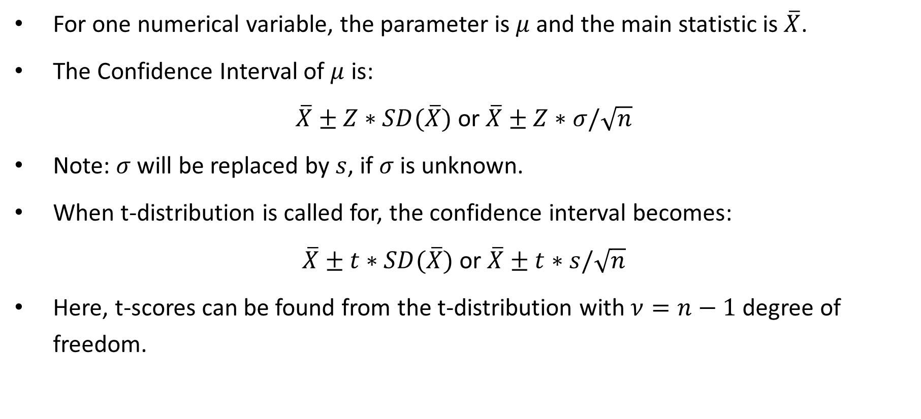
Confidence Intervals (Means)
For one numerical variable, the parameter is $μ$ and the main statistic is $\overline{X}$.
The Confidence Interval of $μ$ is:
$\overline{X}±Z∗SD(\overline{X})$ or $\overline{X}±Z∗σ/\sqrt{n}$
Note: $σ$ will be replaced by $s$, if $σ$ is unknown.
When t-distribution is called for, the confidence interval becomes:
$\overline{X}±t∗SD(\overline{X})$ or $\overline{X}±t∗s/\sqrt{n}$
Here, t-scores can be found from the t-distribution with $ν=n−1$ degree of freedom.

Slide 11
Example 2
A teacher wants to find out how much time (in minutes) students listen to music per day. A random sample size of 36 students is drawn and the average is 165 minutes. Suppose the variable of interest does not have a Normal distribution, but the standard deviation is known to be 75 minutes (from past experience).
a) Define the parameter of interest. Can you explain why its value is unknown?
b) Estimate the parameter using 80% confidence level.
c) Check appropriate conditions, if necessary.
Notes:
a) Parameter
Define mu as the average amount of time all students listening to music per day.
b) 80% Confidence Interval of mu
80% CI means the middle-area is 0.80. That also means we have two 10% on either sides.
Using CA = 0.1003 (closest to 0.1000) and look up the Z-table, we get a Z-score of -1.28.
-> 165 +/- 1.28*75/sqrt(36) = 165 +/- 16
Note: the standard deviation of 75 minutes is sigma (population standard deviation)
c) Condition checking
Since the shape of the numerical variable is not Normal, we need to apply the CLT by making sure the sample size is 30 or more.
Here, n = 36, which is bigger than the requirement of 30.
Because the condition is satisfied, the approximation here is good (enough).

Slide 12
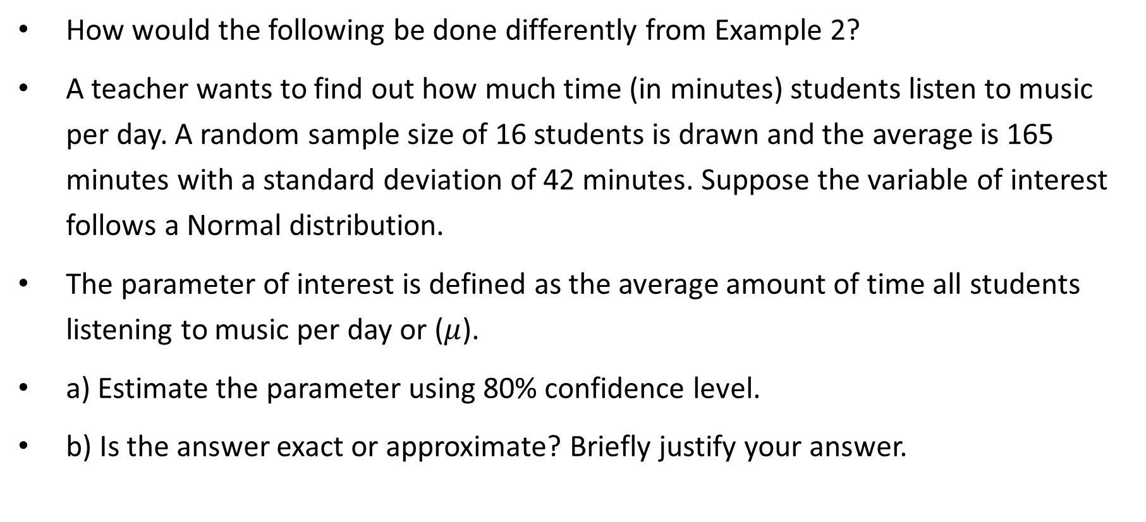
Example 3
How would the following be done differently from Example 2?
A teacher wants to find out how much time (in minutes) students listen to music per day. A random sample size of 16 students is drawn and the average is 165 minutes with a standard deviation of 42 minutes. Suppose the variable of interest follows a Normal distribution.
The parameter of interest is defined as the average amount of time all students listening to music per day or ($μ$).
a) Estimate the parameter using 80% confidence level.
b) Is the answer exact or approximate? Briefly justify your answer.
Notes:
a) 80% Confidence Interval of mu
80% CI means the middle-area is 0.80. That also means we have two 10% on either sides.
With n = 16, the degree of freedom = n – 1 = 15
Using Upper Tail Area of 0.1000, and look up the t-table (along the row DF of 15 and under the column 0.1000), we get a t-score of +1.3406.
-> 165 +/- 1.3406*42/sqrt(16) = 165 +/- 14.1
Note: the standard deviation of 42 minutes is the sample standard deviation.
b) Condition checking
Although there aren’t any conditions to check, let’s make sure all requirements are there to use the t-distribution.
X has a Normal shape: checked
Sigma is not known and s is used instead: checked
-> The answer is exact.

Slide 13
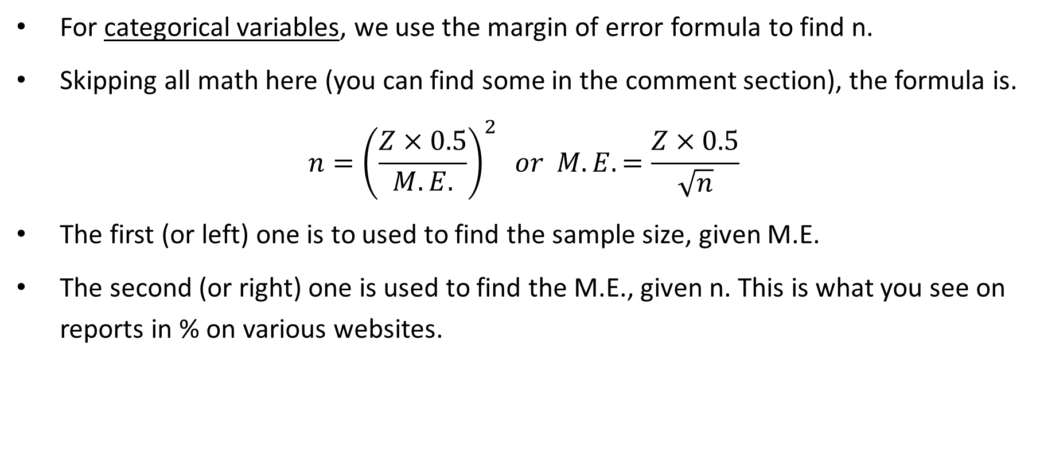
Sample Size Determination
For categorical variables, we use the margin of error formula to find n.
Skipping all math here (you can find some in the comment section), the formula is.
$$n={\left(\frac{Z×0.5}{M.E.}\right)}^{2} or M.E.=\frac{Z×0.5}{\sqrt{n}}$$
The first (or left) one is to used to find the sample size, given M.E.
The second (or right) one is used to find the M.E., given n. This is what you see on reports in % on various websites.
n | 1,000 | 2,945 | 1,878
M.E. | 0.03099 | 0.01806 | 0.02250
Notes:
Previously: ME = Z * sqrt[ p*(1 – p)/n ]
Fact: f(x) = x*(1 - x) is the biggest when x = 0.5
-> Plugging p = 0.5 and we get the formula.

Slide 14
Any Questions?

